Slide 1
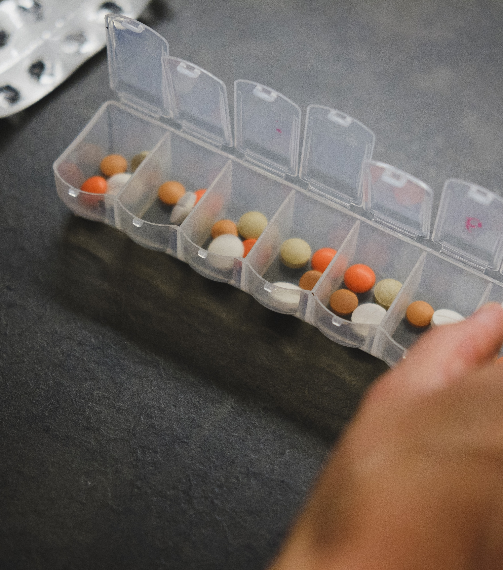
Women
Techies
Team: Lisp_wags

Slide 2
Existing Problem
1. Prescription authenticity currently being relied on physical signature of Doctors’ text which could lead to forgery
2. Illegibility and difficulty to understand prescriptions
3. Untimely Notification makes number of treatable patients smaller

Slide 3
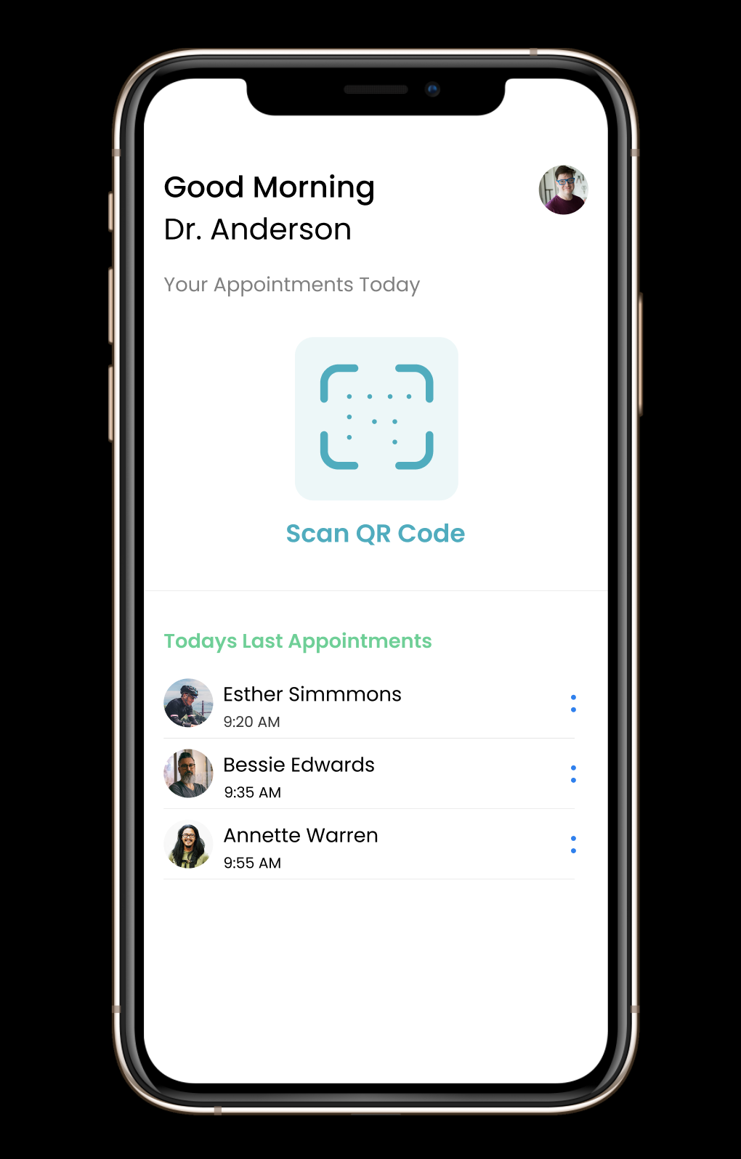
Proposed Solution
The Solution is to create a Medical Health Care interface between the doctor and patient.
1. Prescription authenticity by relying on Cryptographic Principle instead of verifying physical signature of Doctors’ text
2. Illegibility and difficulty to understand prescriptions
3. Timely Notification to take medicine since the process ( Doctor Speaking + Auto Signature) will overall save time

Slide 4
Novelty
Digitisation of Medical Prescription through Blockchain in the 21st century
E prescription with Signature using public and private key.
Voice generative Prescription Parser through Speech
Common Public’s Integration with Blockchain

Slide 5
Workflow
1. Patient arrives at the hospital or clinic and opens his Mobile Application
2. The doctor uses his application to scan a QR code of the patient's unique public address.
3. The doctor dictates the prescription in a standard format from which the different components can be separated.
4. The backend receives this text and parses it to create an object. It hashes this object and stores this in the database.
5. This hash is sent back to the doctor which is digitally signed by the doctor using cryptographic methods.
6. This hash is verified through the blockchain and the patient can view his digitally verified prescription on his phone.

Slide 6
Business solution /Social Impact
Doctors’ Perspective
Patients’/Socials’ Perspective
Serve as a digital footprint for the Hospital/Clinic. This is better than the existing methods since the whole process of digitalisation is faster and more reliable in process since no middleman is required.
Save the time to give prescriptions by which he can work on the main task and diagnose more patients
Patient can easily access medical records given by the doctor
If the doctors have a problem- For example with the legibility of handwritten text since the prescription is digitalised then chemists could understand the legibility of doctors easily

Slide 7
Scope for Improvement
Relying on Proof of Authority instead of Proof of Work will help us save a certain amount of time and make the application scalable
Verifying Doctor’s authenticity by his licence number through Indian Medical Registry (IMR) and doing Image Processing of his licence.
Implementing smart Contracts through Hyperledger ( Plans will be to build the blockchain from scratch in the future
Inclusion of chemists/pharmacists in the blockchain giving medicines to patients to also reduced forgery of selling of medicines
Inclusion of a predictive text parser with automated speech parser

Slide 8
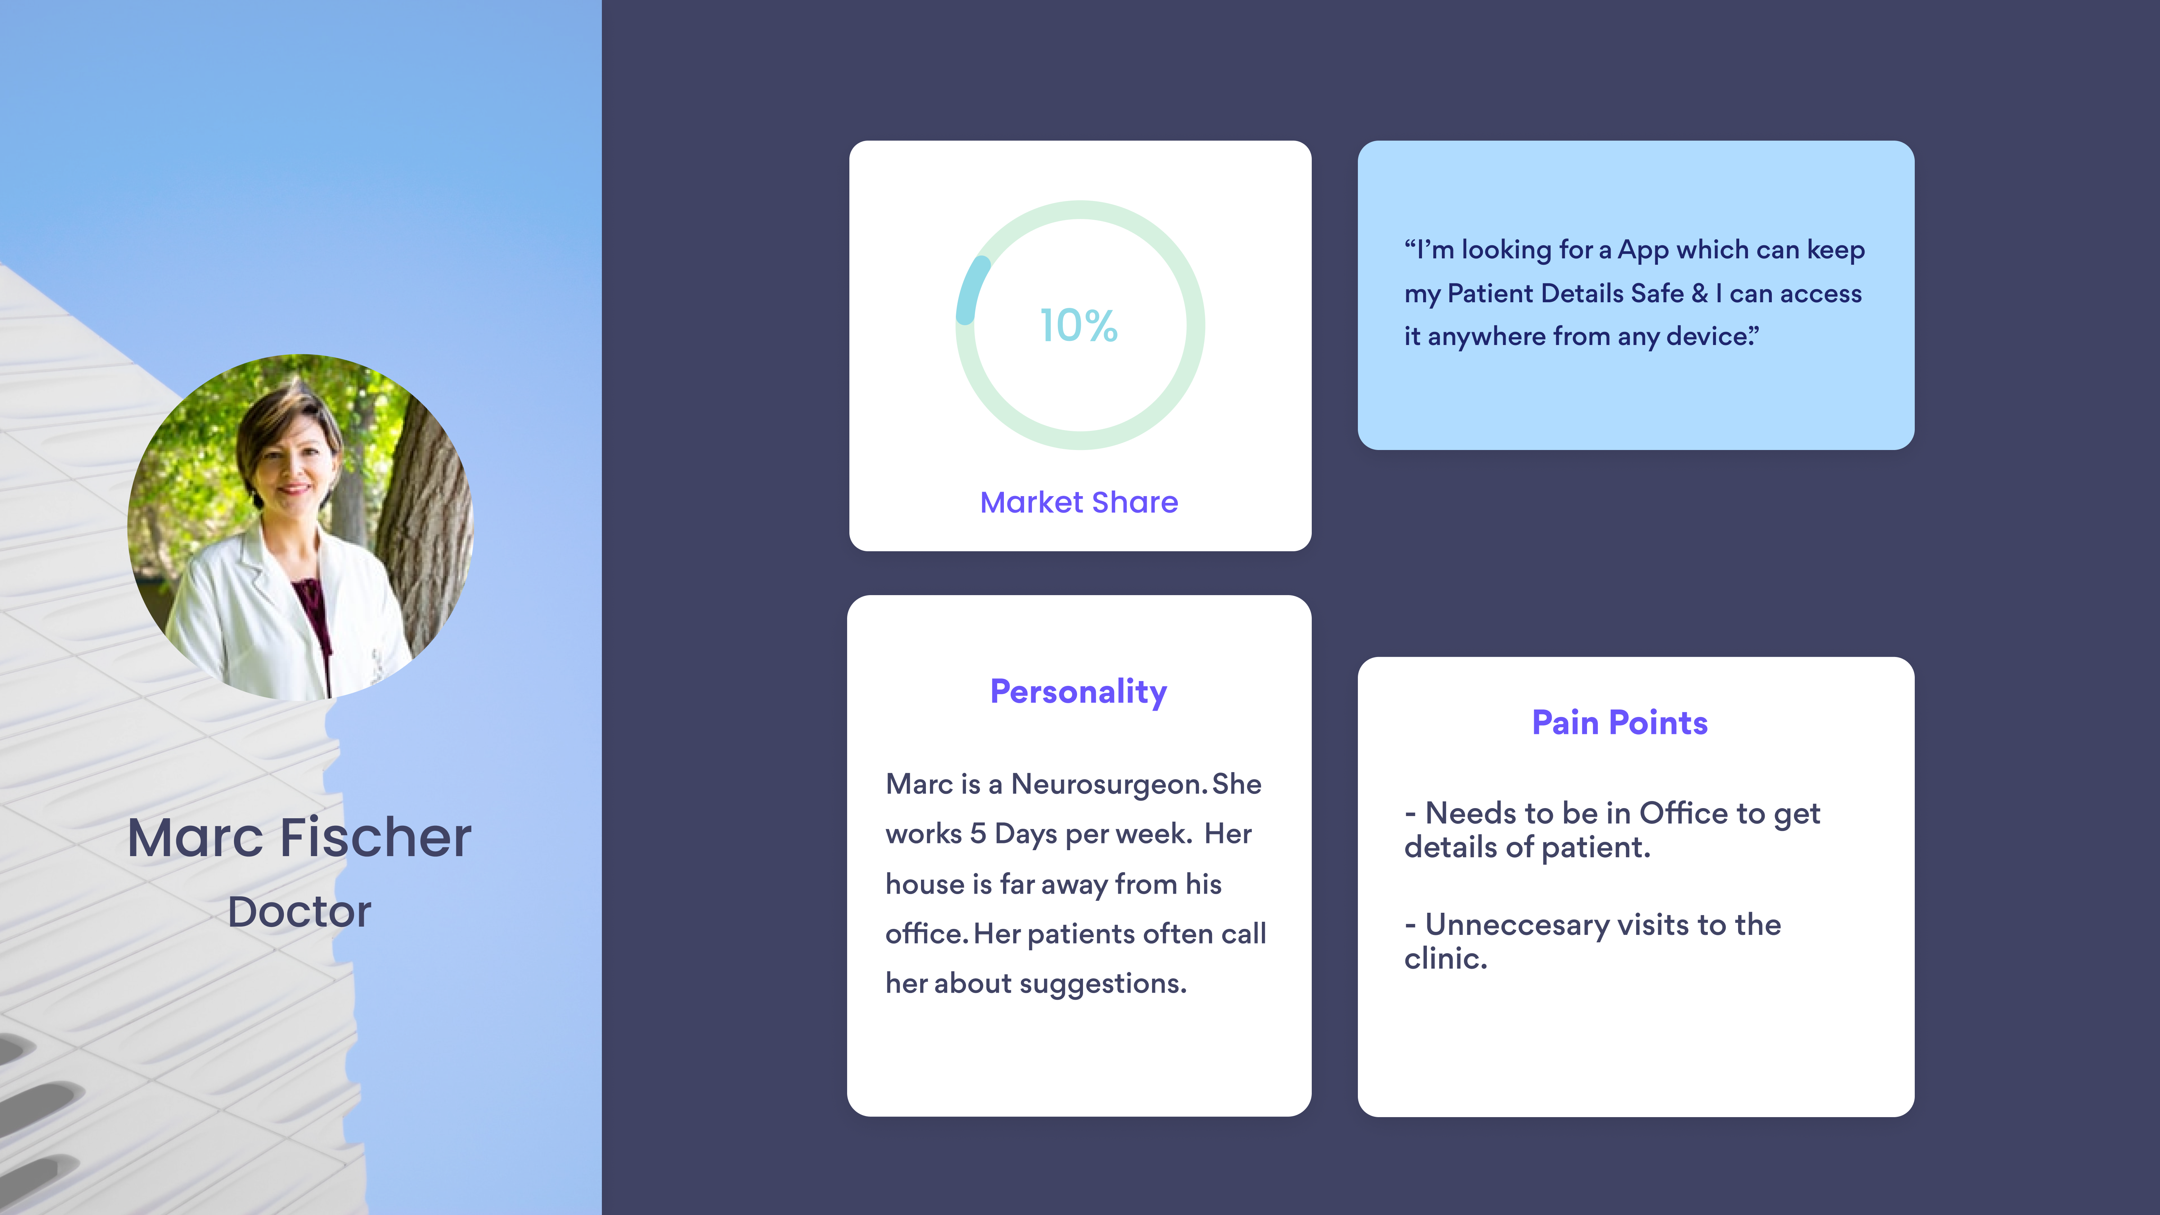
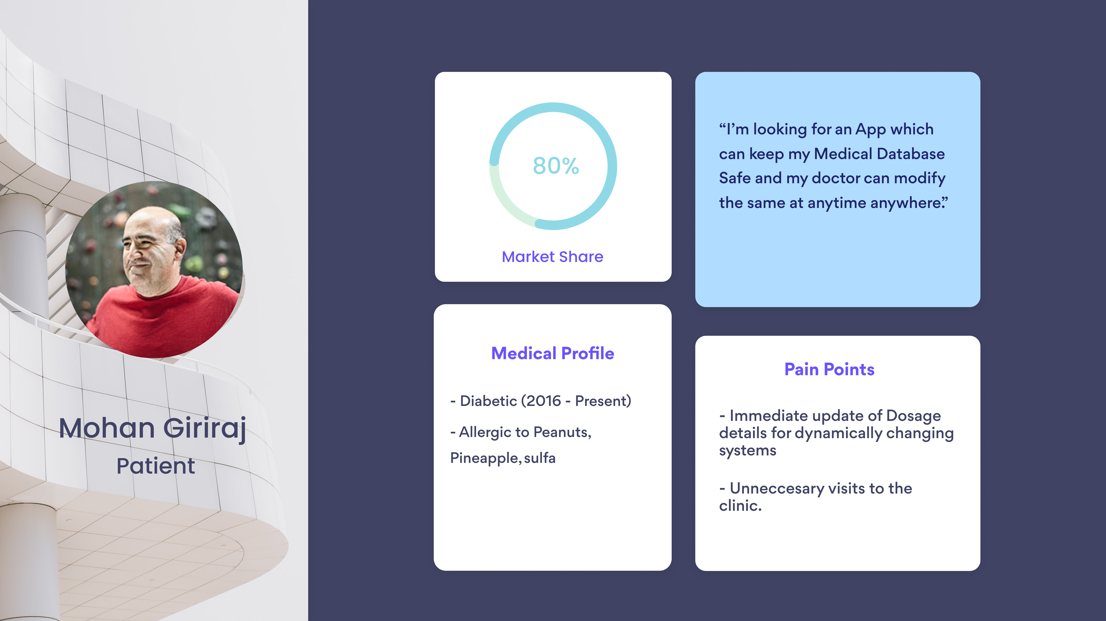
Unique Selling Point
Digitisation of Medical
Prescription

Slide 9
Unique Selling Point
Digitisation of Medical
Prescription

Slide 10
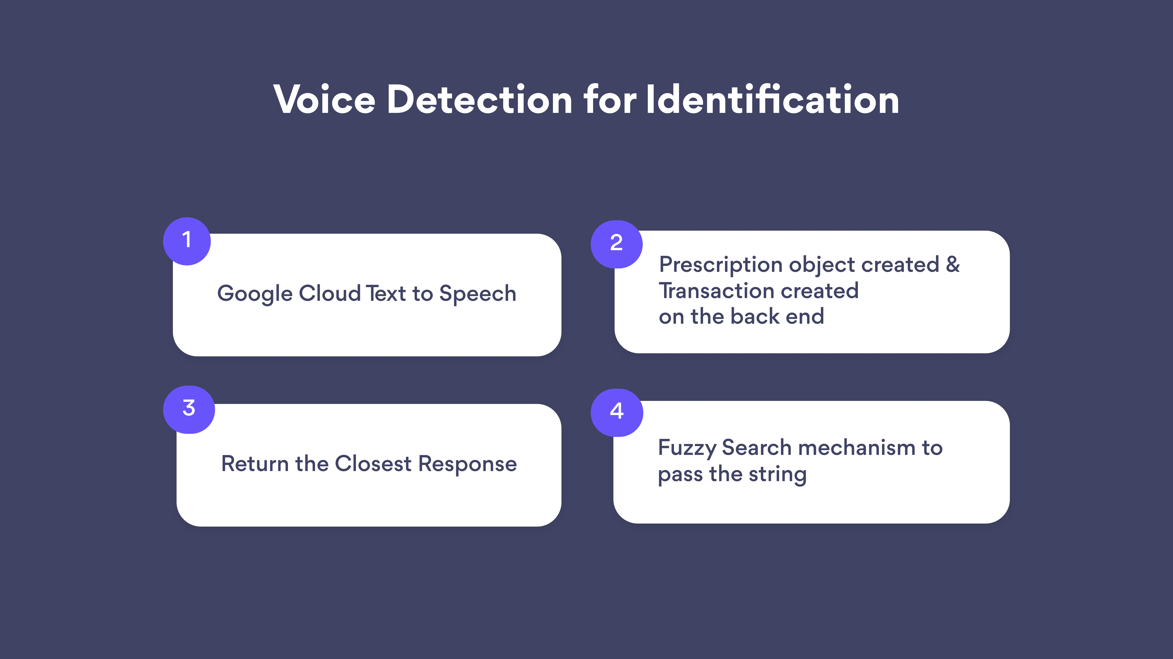
Voice Detection for Identification
Google Cloud Text to Speech
Return the Closest Response
Fuzzy Search mechanism to pass the string
Prescription object created & Transaction created on the back end

Slide 11
Speech - to - Text
The speech detection component of the application is powered by Google Cloud Speech to Text API.
Our application prototype is built on React Native which has community support for voice recognition based on the aforementioned API.
The recognised text is sent to a REST API build on Node.js and Web3.js which enables us to persist the prescription signature over our custom built blockchain.
The backend parses the text into three seperate components i.e the name of the medicine, the dosage amount and the advised frequency.

Slide 12
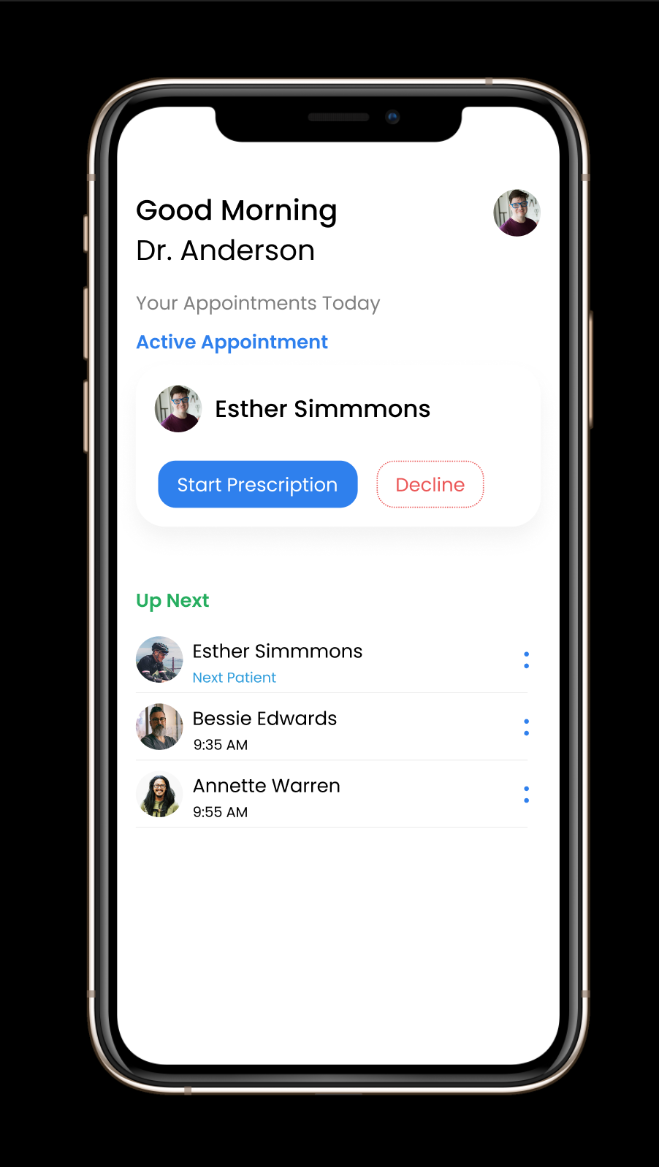
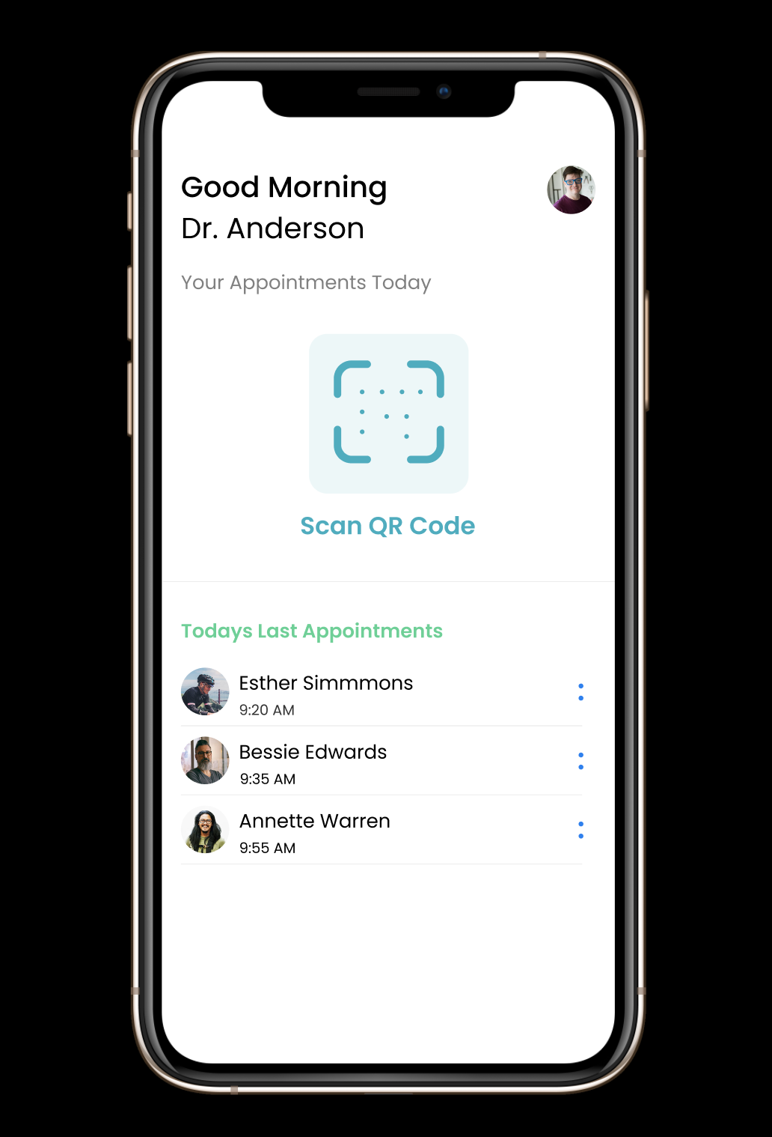

Slide 13
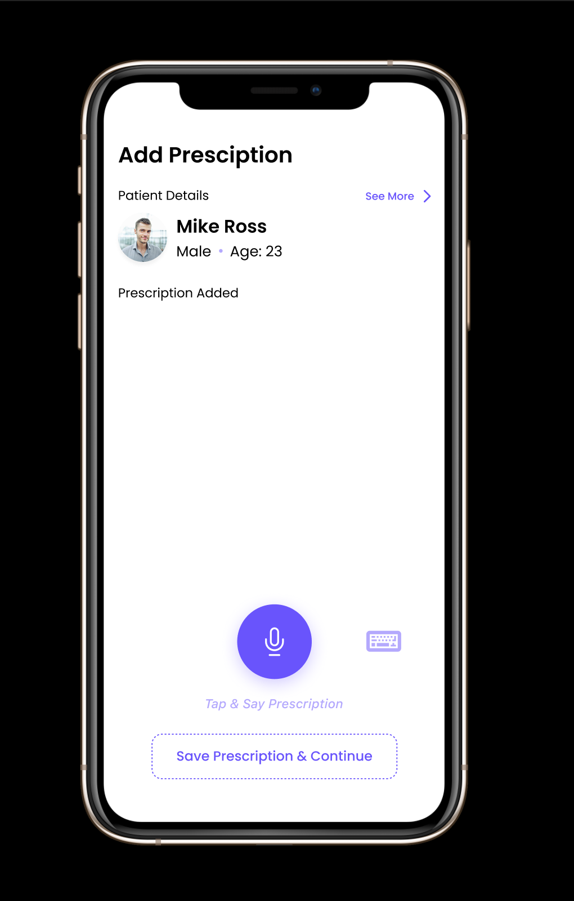
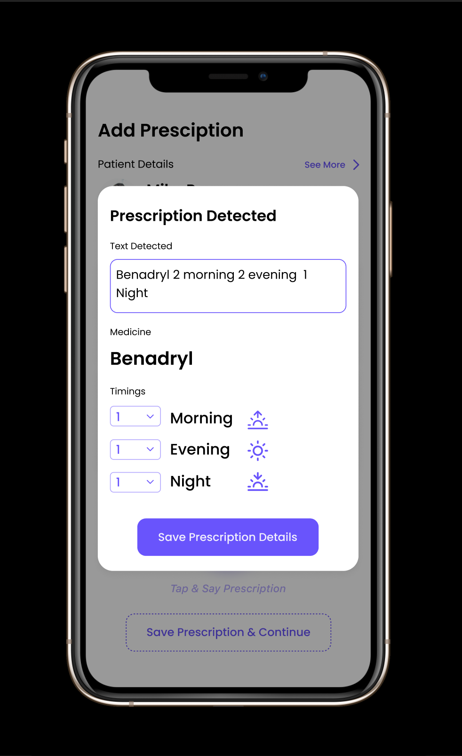

Slide 14
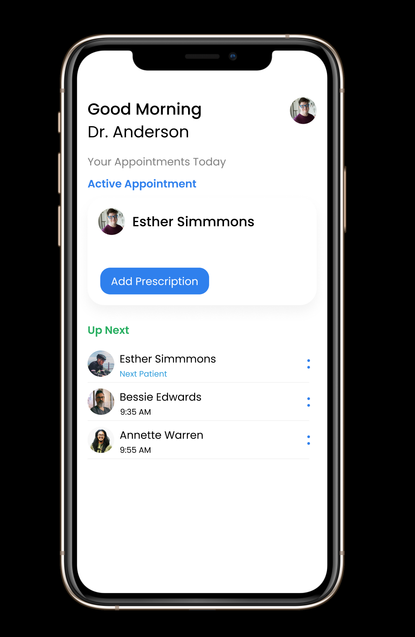
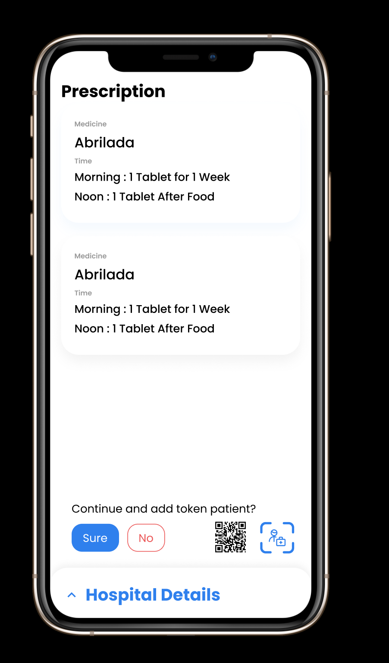

Slide 15
THANK YOU!

